Slide 1
THE BEST COMPUTERS FOR THE BEST PRICES

Slide 2
Laptop for the English teacher

Slide 3

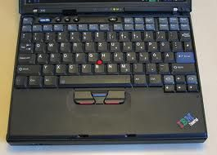
Technical data sheet
Processor : Intel Pentium M 738 - 1.4GHz
Batterie : 4200mAh – 7.5 hours
Screen : 12.1 In (1024 x 768)
Hard Disk : 40GB
RAM : 512 MB
OS : Windows XP
(compatible with Linux)

Slide 4
PRICE :
53.70 € on priceminister

Slide 5
Desktop for the English teacher

Slide 6
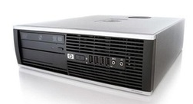
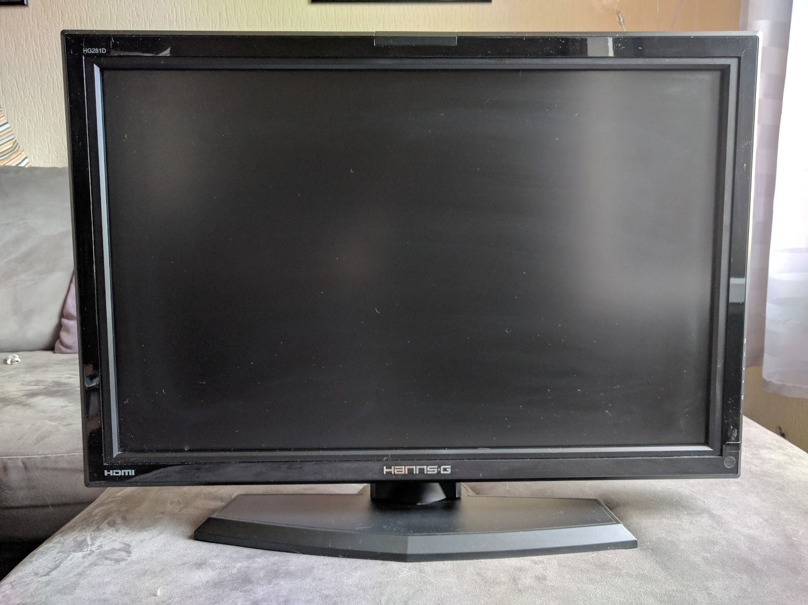
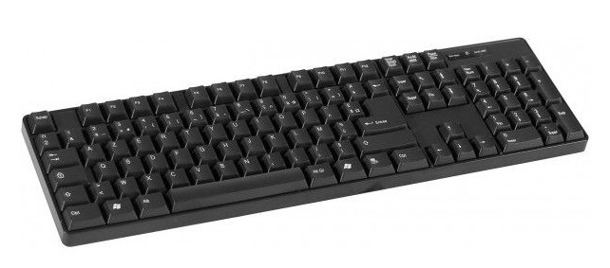
Technical data sheet
Graphic Card
Processor : AMD Athlon II 2.70Ghz
Screen : 28 In (Ebay)+VGA
Keyboard : Dacomex
Mouse : HP (Fnac)
Hard Disk : 250GB
RAM : 2GB
OS : Windows 7
(compatible with Linux)

Slide 7
PRICE :
47+10+3.99+0.90+6.47
=
68.36€

